Slide 1
Architecting for ACES
Operational view

Slide 2
Environment diagram & development stakes
OEM
Automotive suppliers
Technological partners
Governmental organisations
Non Governmental Organisations
- Preservation of environment
- regulation/emissions control
- monitoring the application of emissions standard
- RGPD standard
Meet regulations standard
Minimize penalities regarding emission
Addressing new markets
Reduce pollution and promotion of recycling energy
Promotion of the energy transition → zero carbon footprint
Users
Vehicle
« How to design a vehicle that eases stakeholder’s lives through digital transformation »
Emergency teams
- Financial
- Availability of his vehicle ( autonomy)
- Preservation of environment
Adults
Children
Life prevention (car user and emergency team)
Rescue team
Medical team
Police
Purchasing & maintenance experience improvement
Steal battery
Interrupt the recharging
Hack the vehicle recharging
Hack the vehicle
Secure Infrastructure services
Sizing of the infrastructure & speed (improving charging speed)
Car dealers
Infrastructure
Malicious people
Sales agents
After sales agents
Road
infrastructure
Energy supply
infrastructure
Communication
infrastructure

Slide 4
Description des parties prenantes (4/4)
OEM
Car manufacturer
AUTOMOTIVE SUPPLIERS
Classical automotive suppliers
TECHNOLOGICAL PARTNERS
Information technology companies (ex. : Google, Apple, Spotify,…)
NON GOVERNMENTAL ORGANISATIONS
Organisations promoting societal changes and influencing policy makers
GOVERNMENTAL ORGANISATIONS
Policy makers at every levels (local, national, supranational)

Slide 5
Description des parties prenantes (3/4)
USERS
The benefitors of the mobility services (adults & children)
MALICIOUS PEOPLE
Unauthorised benefitors of the mobility services or threats to the nominal usage of the mobility services.
EMERGENCY TEAMS
Teams called for in case of emergency
INFRASTRUCTURE
Services infrastructure provided to vehicle and infrastructure constraints imposed upon the vehicle.

Slide 6
Needs
USERS
The user shall be able to spend 8 k€ by year for 3 years in operating
The user shall be able to make 100 km / week without any interruption in operating phase
The user shall be able to finish the preparation of his car within 20 min in operating phase
MALICIOUS PEOPLE
EMERGENCY TEAMS
INFRASTRUCTURE

Slide 8
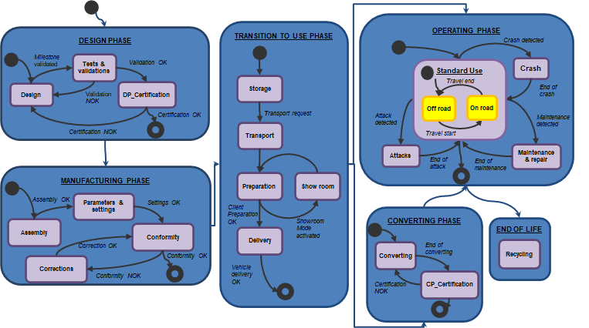
Vehicle lifecycle

Slide 9
Use-cases – E-mobility
User
Car dealers
UC1
prepare the vehicle
UC3
Riding in the town
Road
Infrastructure
UC5
Gather pollutions data
Governmental organisations
(e)
UC2
Prevent plug-removal during recharge
Energy Supply
Infrastructure
UC4
Inciting to e-mobility transition
Maliciouspeople
Car dealer
OEM

Slide 10
Operational analysis metamodel
Actor
Lifecycle
phases
Is active in a
Is involved in a
Has a
takes place in a
UC
Scenarios
Need
Tell the story
associates to the UC
Specifies a

Slide 11
UC3-SC1- entering in a regulated zone of the city
user
infrastructure
Police
Vehicle
Alt
Low emission certificate request
Low emission certificate
agreement
Authenticate zero emission attribute
Low emission certificate request
Low emission certificate
agreement
Acknowledgement message

